Slide 1
Data Preprocessing 2

Slide 2
Outline
Part 1 (Last Week)
Why preprocess the data?
Data cleaning
  Incomplete
  Noise
  Inconsistent
Part 2 (This Week)
Data integration
Data transformation
Data reduction
Summary

Slide 3
Data Integration
Data integration:
  Combines data from multiple sources into a coherent store
Schema integration: e.g., A.cust-id = B.cust-#
  Integrate metadata from different sources
Entity identification problem:
  Identify real-world entities from multiple data sources, e.g., Bill Clinton = William Clinton
Detecting and resolving data value conflicts
  For the same real-world entity, attribute values from different sources are different
  Possible reasons: different representations, different scales, e.g., metric vs. British units

Slide 4
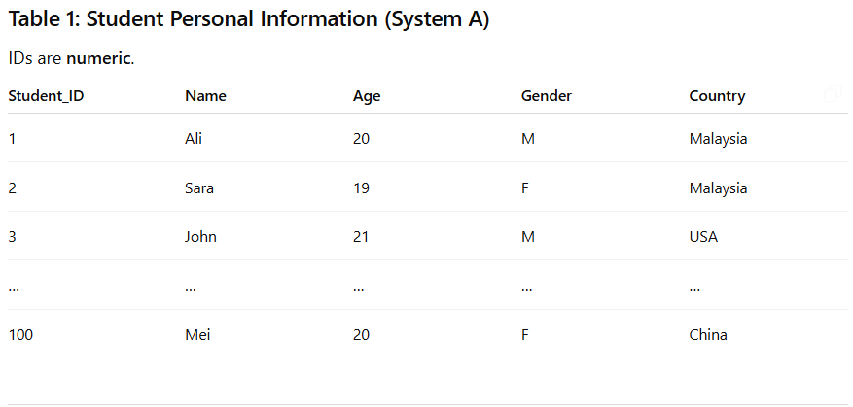
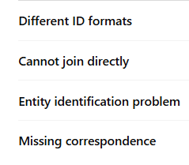
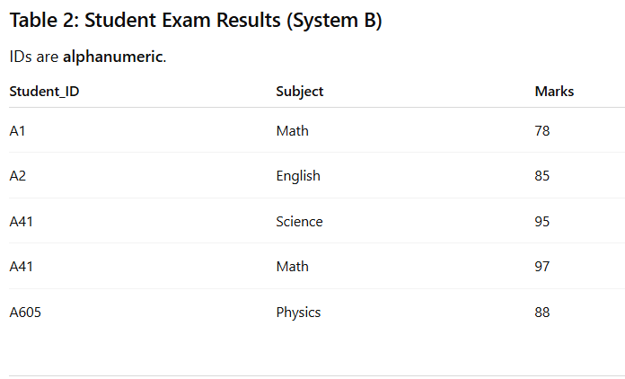
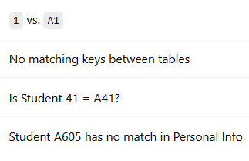

Slide 5
Handling Redundancy in Data Integration
Redundant data occur often when integration of multiple databases
  Object identification: The same attribute or object may have different names in different databases
  Derivable data: One attribute may be a “derived” attribute in another table, e.g., annual revenue
Redundant attributes may be able to be detected by correlation analysis
Careful integration of the data from multiple sources may help reduce/avoid redundancies and inconsistencies and improve mining speed and quality
Unifying data – convert GBP to USD
Ways to Integrate Data
  merge
  concat

Slide 6
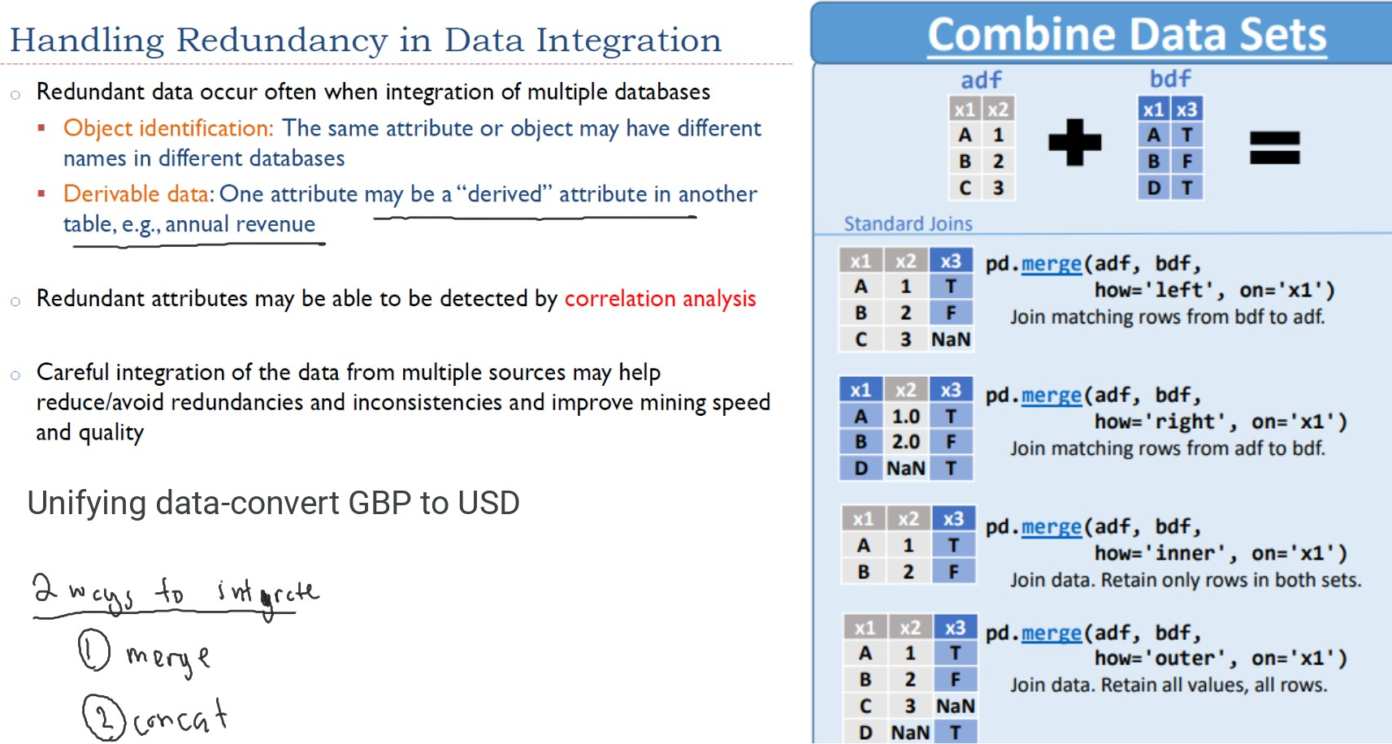

Slide 7
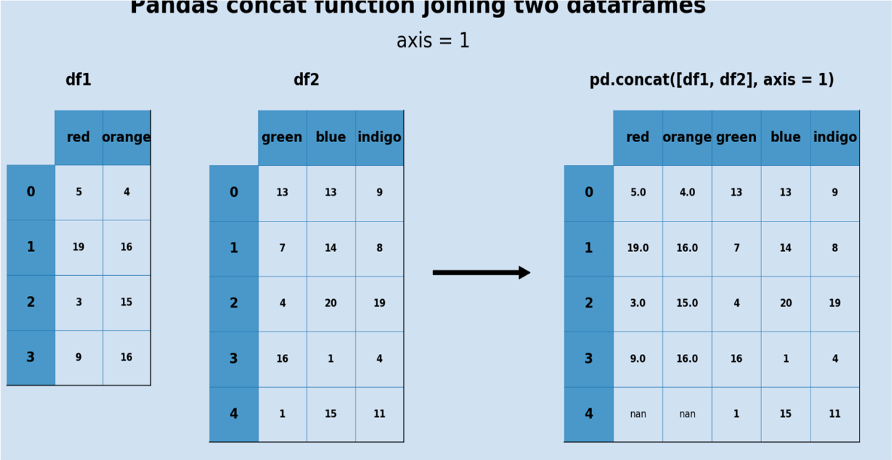
Pandas concat function joining two dataframes

Slide 8
Question:
What is the difference between merge and concat?
When do we use concat or merge?

Slide 9
Scenario | Use | Why
Combine student info with their marks | merge | They share Student_ID
Combine Jan, Feb, Mar sales | concat | Same structure, more rows
Combine demographic data with exam scores | merge | Need to match students
Combine two feature datasets side-by-side | concat | Columns aligned by index
Combine two unrelated tables | concat | No common key
Add missing columns via join | merge | Based on key

Slide 10
Data Transformation
A function that maps the entire set of values of a given attribute to a new set of replacement values such that each old value can be identified with one of the new values.
Methods
  Smoothing: Remove noise from data
  Aggregation: Summarization, data cube construction
  Generalization: Concept hierarchy climbing
  Normalization: Scaled to fall within a small, specified range
    min-max normalization
    z-score normalization (standard scale)
    normalization by decimal scaling
  Attribute/feature construction:
    New attributes constructed from the given ones

Slide 11
Example of Data Aggregation (Student Marks → GPA)
Student ID | English (Eng) | Math | CS | ...
0061 | 79 | 88 | 90 | ...
0062 | 72 | 81 | 85 | ...
… | … | … | … | …
0200 | 65 | 70 | 75 | ...
After Aggregation
Student ID | English (Eng) | Math | CS | ... | Average of All Marks | GPA
0061 | 79 | 88 | 90 | ... | 85.7 | 3.5
0062 | 72 | 81 | 85 | ... | 79.3 | 3.2
… | … | … | … | … | … | …
0200 | 65 | 70 | 75 | ... | 70.0 | 2.8

Slide 12
Example of Generalization (City → State)
City | State
Shah Alam | Selangor
Kajang | Selangor
Klang | Selangor
Georgetown | Penang
Butterworth | Penang
Kota Bharu | Kelantan
... | ...
df["State"].nunique()
Reduced categories: 300 → 14
Easier grouping and analysis
Patterns become clearer
e.g., "Most students come from Selangor and Johor"

Slide 13
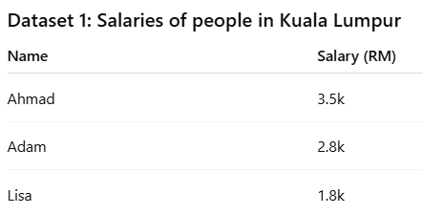
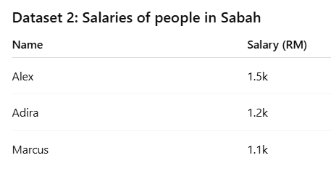
Normalization
Why do we need normalization?
  To give a fair comparison between features
  Different features often have different scales, so normalization helps ensure that no feature dominates the others simply because of its larger numeric range.

Slide 14
Normalization
KL salaries are mostly higher and spread over a larger range.
Sabah salaries are lower and in a smaller range.
If we combine both datasets or use them in a model:
  The KL salary feature will dominate because of its larger numbers.
  Comparisons become unfair.
  Models give biased weight to KL values.
Solution: Normalize
Normalization transforms both salary columns so they are on a common scale, for example:
Range 0 → 1 (min–max)
Mean 0, SD 1 (z-score)
This makes comparisons fair and avoids bias.

Slide 15
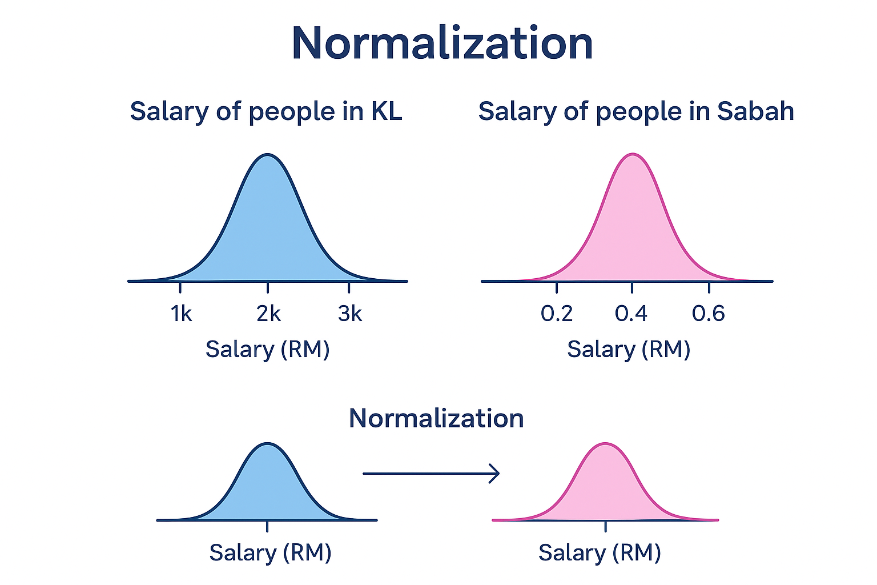

Slide 16
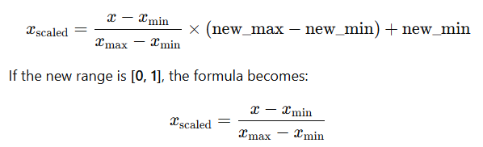
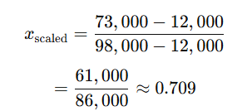
Min–Max Normalization
Rescales a feature to a new range, typically [0, 1]:
Example:
  Let income range from
    min= $ 12, 000
    Max = $98, 000
    Convert $ 73,000:
Notes:
It simply stretches or compresses the data into a new numeric range.

Slide 17
Min–Max Normalization
Rescales a feature to a new range, typically [0, 1]:
Example:
  Let income range from
    min= $ 12, 000
    Max = $98, 000
    Convert $ 73,000:

Slide 18

Given the Min–Max normalization formula below, what is the minimum and maximum range after scaling?

Slide 19
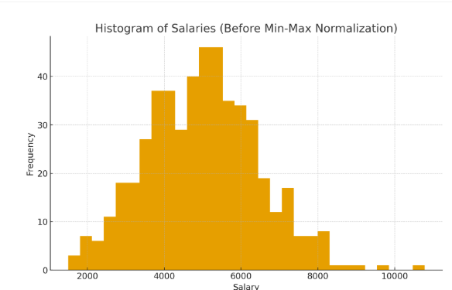
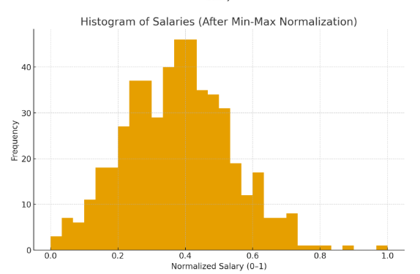

Slide 20
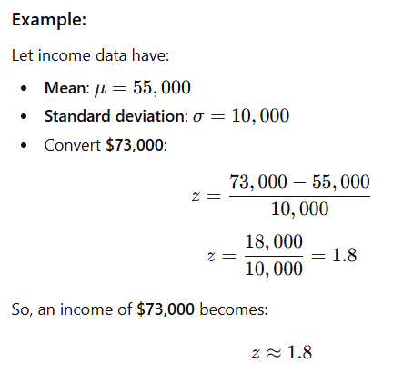
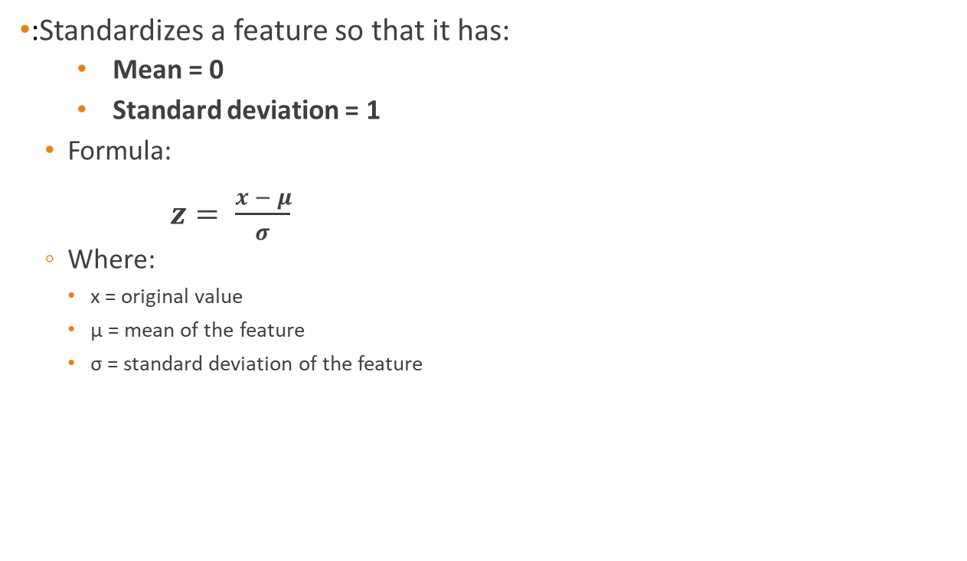
Z-Score Normalization
:Standardizes a feature so that it has:
  Mean = 0
  Standard deviation = 1
  Formula:
$z= \frac{x − μ}{σ}$​
  Where:
    x = original value
    μ = mean of the feature
    σ = standard deviation of the feature

Slide 21
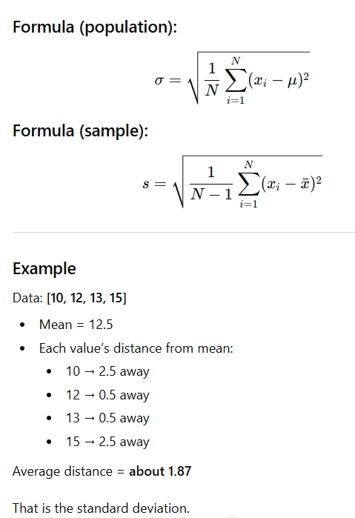
Standard Deviation

Slide 22
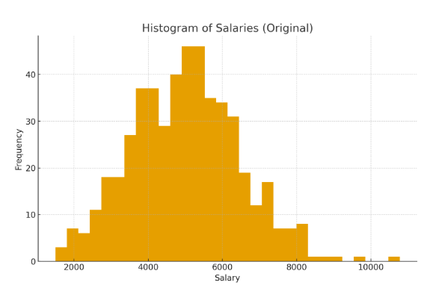
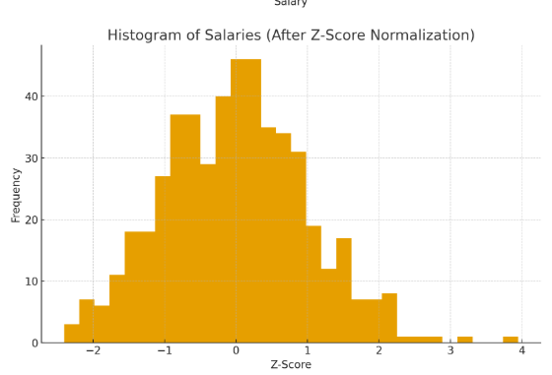

Slide 23


Normalization
Min-max
Z-Score
Very sensitive to outliers
Outliers stretch the range
Squashes normal values
Good only for clean data
More robust
Outliers become large z-scores
Normal data stays centered
Better for noisy datasets

Slide 24
Comparision
Feature | Min–Max Normalization | Z-score Normalization
Scaling Range | 0 to 1 (or custom range) | Centered at 0, typical range −3 to +3
Depends on | Minimum & Maximum | Mean & Standard deviation
Effect | Rescales data proportionally | Standardizes data around mean
Maintains Shape? | Yes | Yes
Unit After Scaling | Still interpretable (0 to 1 scale) | Unitless (std deviations)
Notes:
❌ Shape looks distorted visually/practically

Slide 25
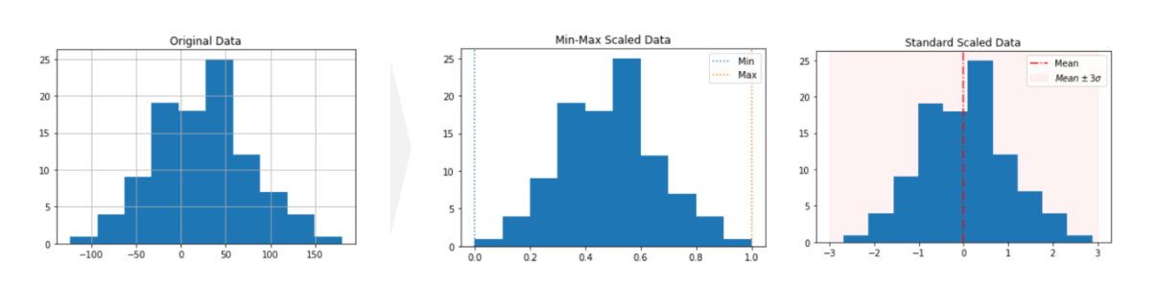
https://h1ros.github.io/categories/min-max-scaling/
https://www.codecademy.com/article/min-max-zscore-normalization

Slide 26
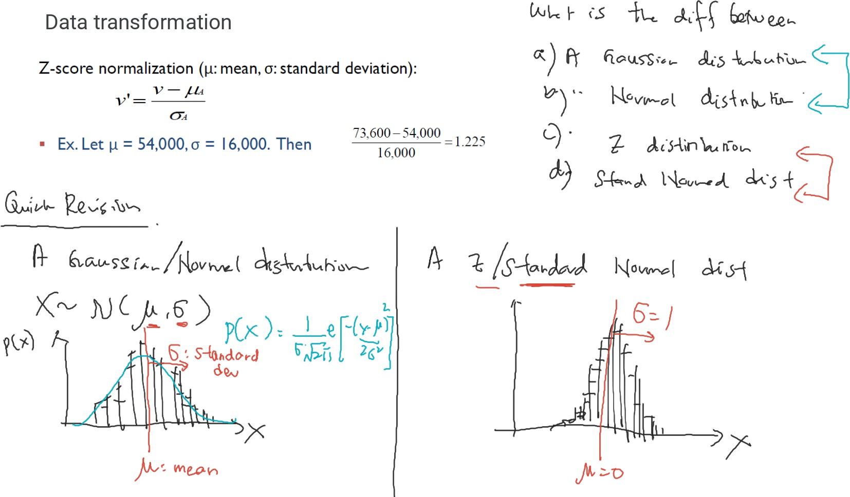

Slide 27
Distributions
Gaussian distribution
Normal distribution
Z-distribution
Standard normal distribution

Slide 28
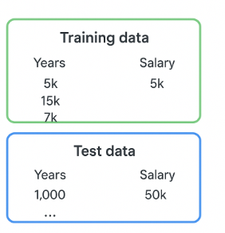
In practice we always split the dataset first, then normalize
Why do we split the data before normalizing?
Training Data
Used to train your machine learning model.
We compute normalization parameters (e.g., min, max, mean, standard deviation) only from this training set.
Test Data
Used to evaluate your model.
We must apply the same normalization parameters obtained from the training data.
do NOT compute new min/max or new μ/σ on the test set.

Slide 29
